Slide 1
Ministerial Health Fellowship
A Program of Cross Street Training and Academic Center (CSTAC)

Slide 2
Our Organization, Mission, Agenda
Cross Street Training and Academic Center (CSTAC) is a Middletown non-profit based at Cross Street AME Zion Church. CSTAC operates the Ministerial Health Fellowship (MHF). MHF is an advocacy coalition comprised of Black faith leaders. MHF addresses health equity concerns by working on state healthcare policy. Below are some of our MHF leaders.

Slide 3
Role of Advocacy in Supporting Our Mission
Advocacy helps faith leaders connect directly with legislators around health equity and policies that affect the communities. Advocacy also heightens awareness that church leaders can be change agents.

Slide 4
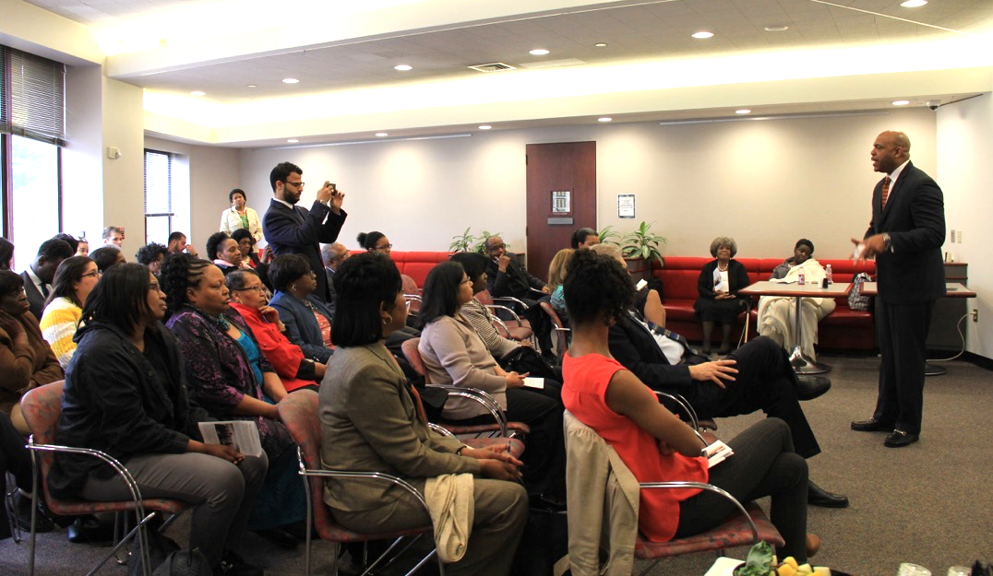
Progress Towards Goals – Objective 1
Engaged 30 church leaders
Worked with Health Equity Solutions this past legislative session to support REL promotion efforts.
Organized a Legislative Breakfast on May 1, 2018 to promote REL data collection, CHWs, and protect Medicare/Medicaid.
Reached goal of 70-100 community attendees, including about 5 legislators and 7 aides.

Slide 5
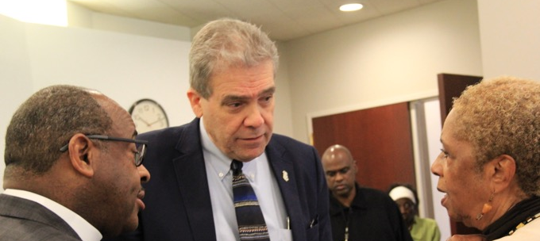
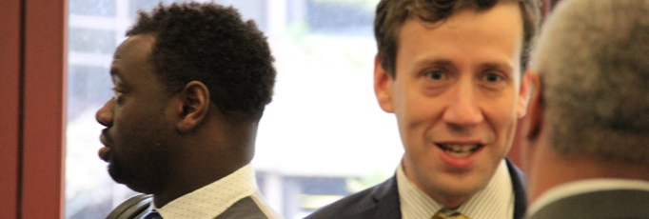
Progress Towards Goals – Objective 2
Identified and targeted 6-8 legislators for one-on-one meetings to educate them about healthcare issues specific to the Black community.
Connected with the following legislators:
Senator McCrory, Rep. Lesser, Rep. Ritter, Rep. Tercyak, Rep. Vargas, Rep. McGee, Rep. Lopes, and Rep. Sanchez.

Slide 6
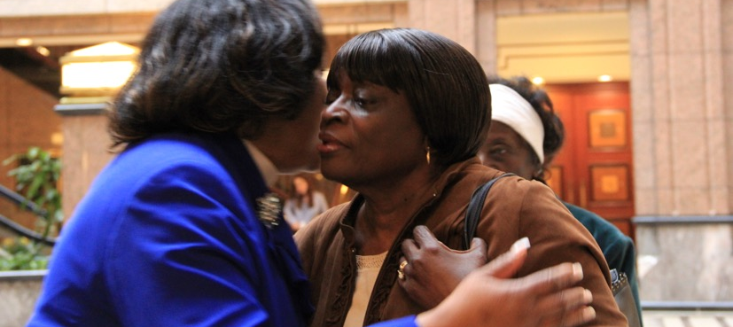
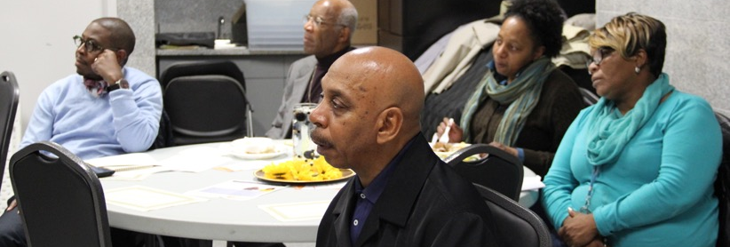
Progress Towards Goals – Objective 3
Working with Middlesex hospital to develop a community initiative to involve faith leaders in helping with healthcare crises.
Catherine Rees, Director of Community Benefits, stated her interest in partnership.

Slide 7
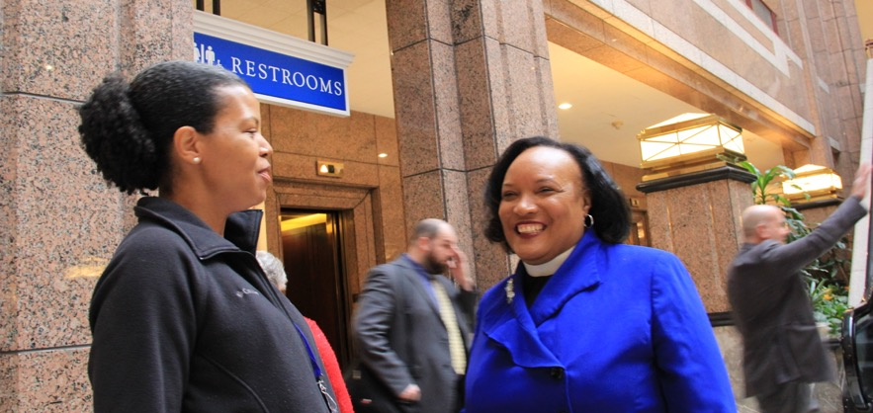
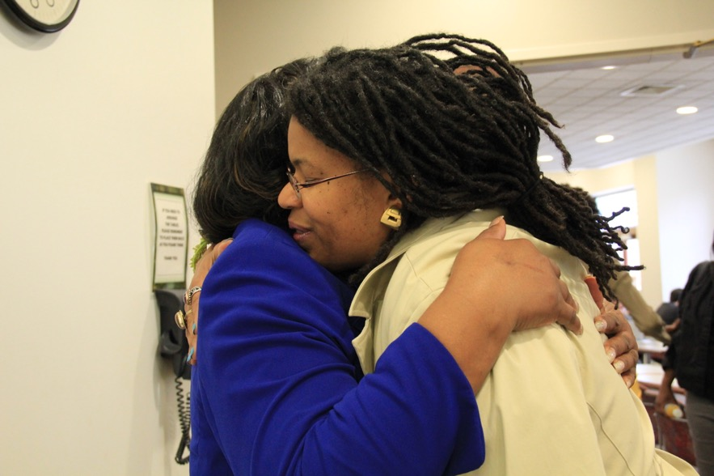
Partnerships
Connected with other advocacy groups like Uconn Health Disparities Institute, and working with healthcare leaders like Marie Spivey, Tekisha Everette, Nichelle Mullens, and Darcy Cobbs-Lomax.

Slide 8
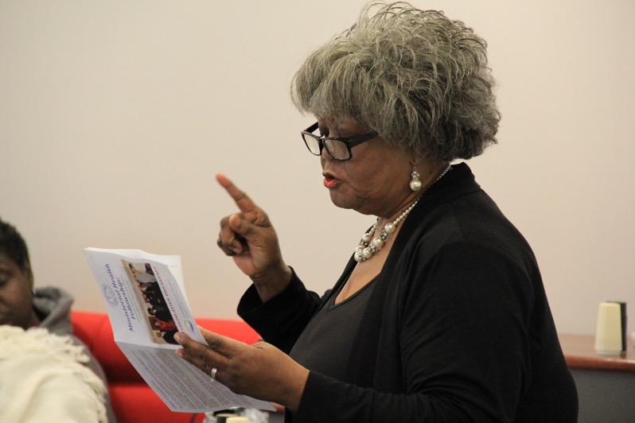
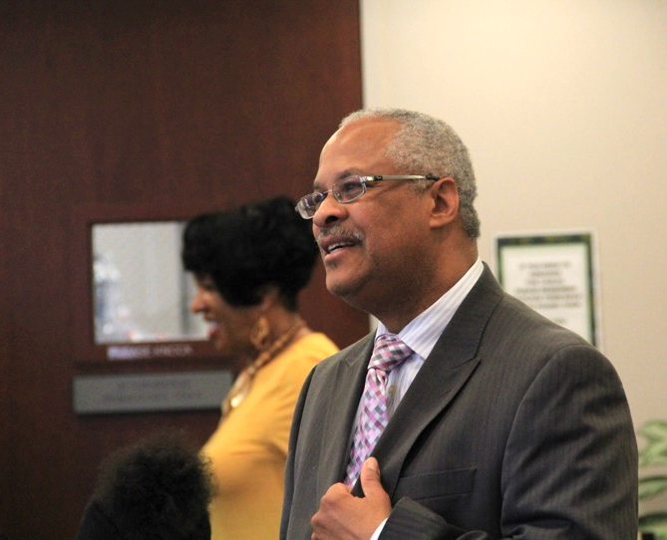
Lessons & Reflections
The MHF has the ability to help transform community members into passionate advocates. As we anticipated, now that we have engaged the trust of church leaders, they bring their congregants and colleagues.

Slide 9
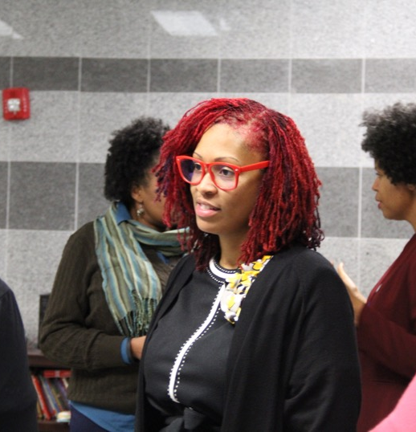
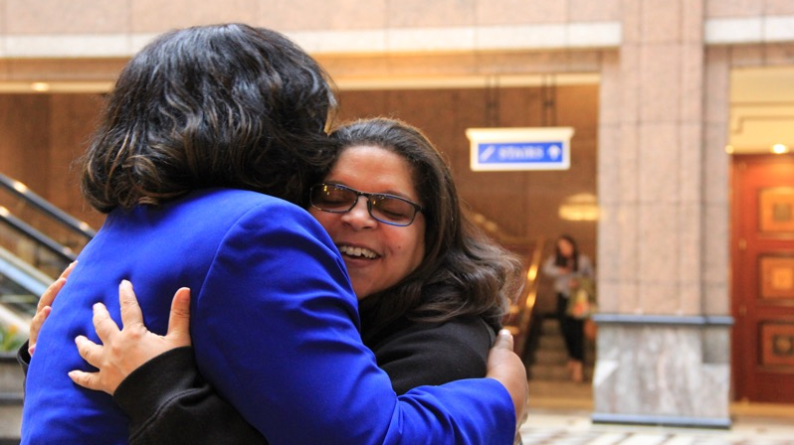
Future Plans
Our coalition sees workforce development and getting people positioned to become Community Health Workers (CHWs) as important goals. We also envision the coalition of churches to be trained as CHWs, especially since Black churches are at the front line to deal with health crises.

Slide 10
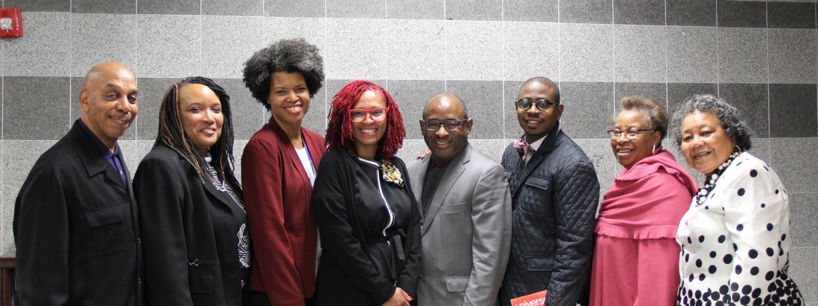
Thank you!

